Slide 1
Data Identification
Identify project goals
Research Data Sources
Validate Data Relevance to Project Goals
Peer Validation
Electricity Data – eia.gov
Data Sources
Data points
Weather data - power.larc.nasa.gov
Government policy data - dsireusa.org
Electricity | Weather | Government Policy
Year | Day | State
Month | Year | Total renewable energy policy count
State | Month | Wind energy policy count
Net generation other renewables (total) (thousand megawatthours) | Latitude | Solar photovoltaic energy policy count
Average retail price of electricity (cents per KWH) | Longitude
Retail sales of electricity (million kilowatthours) | Temperature
Revenue from retail sales of electricity total(million dollars) | Wind speed
Revenue from retail sales of electricity residential (million dollars) | Solar Insolation Index
Total consumption coal (thousand tons)
Total consumption petroleum liquid (thousand barrels)
Total consumption natural gas (thousand Mcf)

Slide 2
Electricity - Data gathering
For all distinct Month, Year, State, Category ∈ X
Get unique webpage X
Use BS4 , Pandas & dump data to a CSV by Category
Year: [2001:2017] Month: [1:12] State: [AL:WY] Categories: [Average retail price of electricity Residential
,Net generation By fuel type All Solar
,Net generation By fuel type Other renewables
,Net generation By fuel type Small scale solar photovoltaic Residential
,Net generation By fuel type Wind
,Retail sales of electricity Residential
,Revenue from retail sales of electricity
,Revenue from retail sales of electricity residential
,Total consumption By sector Electric power (total) coal+petroleum liquids+petoleum coke+natural gas]
Loop

Slide 3
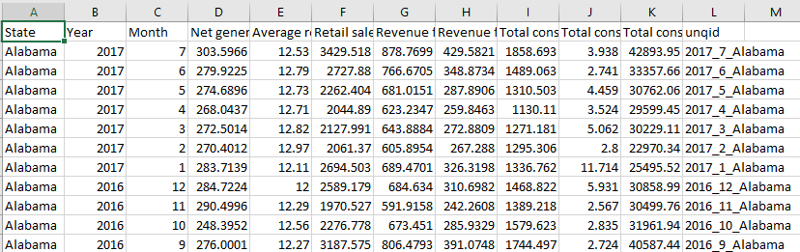
Electricity , Data Consolidation
Create a unique ID column as State_Year_Month for each category
Perform outer join
Remove redundant columns
Perform data accuracy checks by verifying year_month counts and state counts
Dump DataFrame to CSV

Slide 4
Weather - Data Gathering
Stage 1 – Coordinate Identification
Choose a (lat,lon) coordinates to begin with – I started with the Nyugen Building
Set square boundaries for the United States
Get all possible (lat,lon) combinations in that square
Use Google Maps API to label coordinates not in the USA
Remove non-USA coordinates, keep the ones in the country

Slide 5
Weather - Data Gathering
Stage 2 – Data requests and raw dataset generation
Use Selenium to get Insolation Index , Temperature and Wind speed for each coordinate as a text file
Process text file outputs, convert to CSV
Append CSV files into master dataset

Slide 6
Weather - Data Consolidation
Stage 3 – label annotation and data consolidation
Load master dataset in Pandas
Use google maps API to generate State for each coordinate
Aggregate data by month ( from days -> month ) by min , max , mean.
Append data to master dataset and create uniqueID column as State_year_month
Download CSV

Slide 7
Tableau cool visuals go here
My system is pretty overloaded right now . After we discuss the viability of putting the cool GIFs here , I can generate and dump them here .

Slide 8
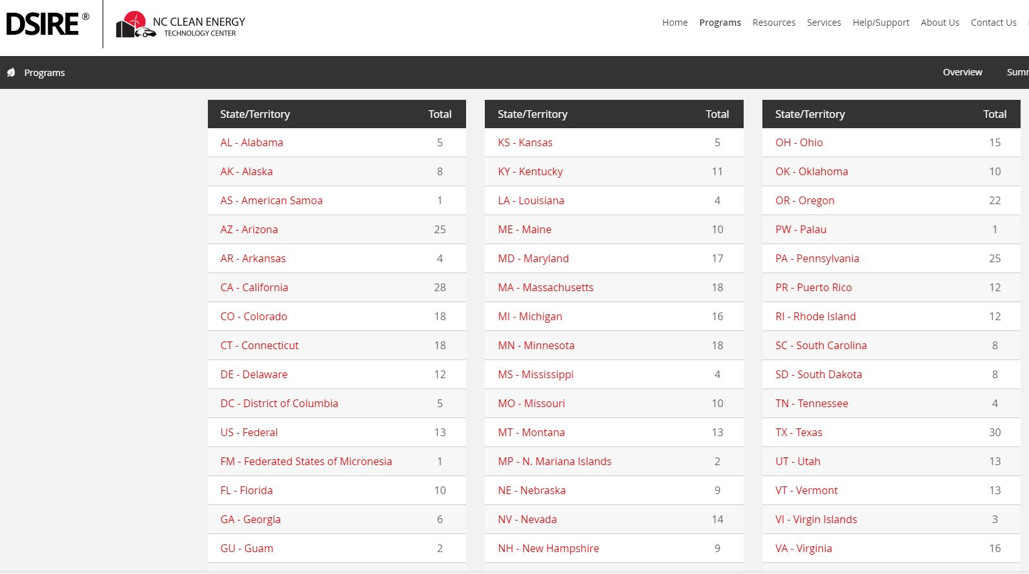
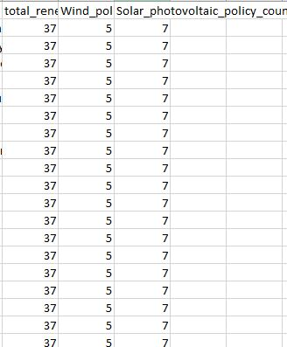
Government policy data – gathering and consolidation
Get to webpage using requests,Pandas,BS4
Add State column
Download as CSV
Download data

Slide 9
Final consolidation
Merge Electricity,Weather,Government datasets
Standardize all units to SI units
Final cleanup
Electricity on State_Year_Month
Weather on State_Year_Month
Government policy on State
Dataset !

Slide 10
How do these two data sources tie in
>Mention the physics we used to get a relationship between wind elec , solar elec . I’m just dumping what we have on the drive here .
>Mention the math on getting CO2 emissions
Total Solar theoretical production at the top layer of earth:
E = 1367 * R^2 * Kt * Cp
1367: Constant
R: Area
Kt: solar radiation index
Cp: (Maximum power coefficient) range [0.24 to 0.34] max at 0.45 -> we will use 0.29
Energy = 1.93 * V^3 * R^2 * Cp (watts)
1.93: Constant
V: Velocity (so, location matters)
R: Radius of the windmill (bigger the diameter of the windmill more generation)
Cp: (Maximum power coefficient) Efficiency [varies from 0.25 to 0.45, with a max of 0.59]
We are using R = 35.3568 [minimum size of blade for a wind mill]
Cp = 0.35
CO2 logic by Britney goes here
Lalala
Lalala
Dank
Wave
Lalalkwifn
3wf
W3gf
3w

